Slide 1
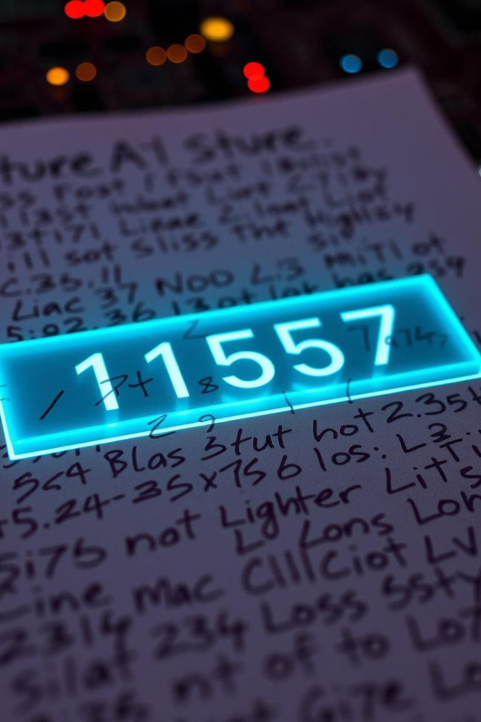
Handwritten Digit Recognition with Deep Learning & Streamlit
AFAF Hajar
EZZERROUTI Salwa
Guided by: Professor MAHMOUDI Abdelhak.

Slide 2
Project Plan Overview
1
Introduction
2
Model Training
3
Streanlit Deployment
4
Model Accuracy
5
Conclusion

Slide 3
What Is the Project About?
Deployment Meaning
Project Goal
Deployment makes a model accessible to users via apps or tools.
Build a deep learning model to recognize handwritten digits swiftly through a Streamlit interface.

Slide 4

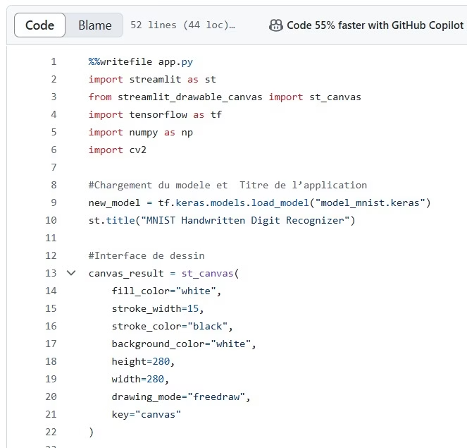
GitHub Repository

Slide 5

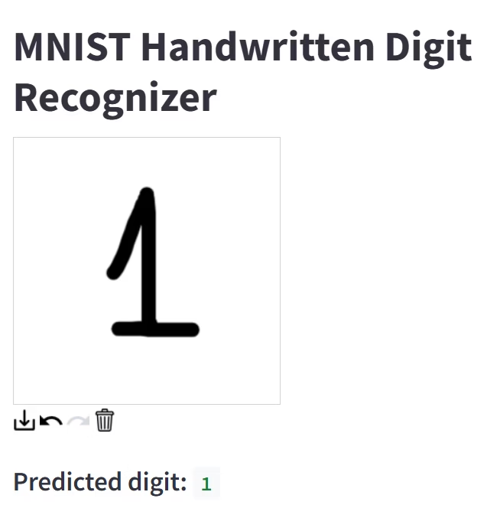
Conclusion & Key Takeaways
Model Validity
User Accessibility
The deep learning model achieves high accuracy in digit recognition.
Streamlit deployment ensures easy and interactive usage.
Future Potential
Expanding to other handwritten characters and real-time applications.

